Slide 1
Basic Cryptography
HNDIT2301: Operating System and Information Security
Week – 2

Slide 2
Classical Encryption
Techniques
Many savages at the present day regard their names as vital parts of themselves, and therefore take great pains to conceal their real names, lest these should give to evil-disposed persons a handle by which to injure their owners. —The Golden Bough, Sir James George Frazer

Slide 3
Symmetric Encryption
or conventional / private-key / single-key
sender and recipient share a common key
all classical encryption algorithms are private-key
was only type prior to invention of public-key in 1970’s
Notes:
All traditional schemes are symmetric / single key / private-key encryption algorithms, with a single key, used for both encryption and decryption, since both sender and receiver are equivalent, either can encrypt or decrypt messages using that common key.

Slide 4
Basic Terminology
plaintext - the original message
ciphertext - the coded message
cipher - algorithm for transforming plaintext to ciphertext
key - info used in cipher known only to sender/receiver
encipher (encrypt) - converting plaintext to ciphertext
decipher (decrypt) - recovering ciphertext from plaintext
Notes:
Briefly review some terminology used throughout the course.

Slide 5
Basic Terminology – contd.
cryptography - study of encryption principles/methods
cryptanalysis (codebreaking) - the study of principles/ methods of deciphering ciphertext without knowing key
cryptology - the field of both cryptography and cryptanalysis

Slide 6
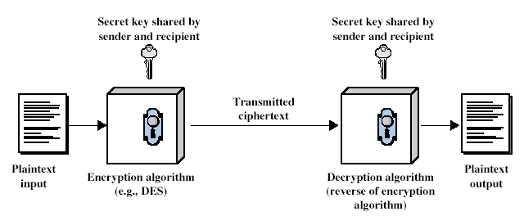
Symmetric Cipher Model
Notes:
Detail 5 ingredients of the symmetric cipher model:
plaintext
encryption algorithm – performs substitutions/transformations on plaintext
secret key – control exact substitutions/transformations used in encryption algorithm
ciphertext
decryption algorithm – inverse of encryption algorithm

Slide 7
Requirements
two requirements for secure use of symmetric encryption:
  a strong encryption algorithm
  a secret key known only to sender / receiver
  Y = E_{K}(X)
  X = D_{K}(Y)
assume encryption algorithm is known
implies a secure channel to distribute key
Notes:
Generally assume that the algorithm is known.
This allows easy distribution of s/w and h/w implementations.
Hence assume just keeping key secret is sufficient to secure encrypted messages.
Have plaintext X, ciphertext Y, key K, encryption alg Ek, decryption alg Dk.

Slide 8
Cryptography
can characterize by:
  type of encryption operations used
    substitution / transposition / product
  number of keys used
    single-key or private / two-key or public
  way in which plaintext is processed
    block / stream

Slide 9
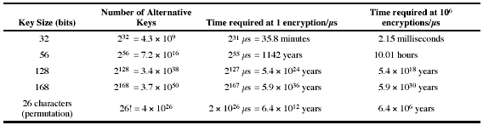
Brute Force Search
always possible to simply try every key
most basic attack, proportional to key size
assume either know / recognise plaintext

Slide 10
More Definitions
unconditional security
  no matter how much computer power is available, the cipher cannot be broken since the ciphertext provides insufficient information to uniquely determine the corresponding plaintext
computational security
  given limited computing resources (eg time needed for calculations is greater than age of universe), the cipher cannot be broken
Notes:
Unconditional security would be nice, but the only known such cipher is the one-time pad (later). For all reasonable encryption algorithms, have to assume computational security where it either takes too long, or is too expensive, to bother breaking the cipher.

Slide 11
Classical Substitution Ciphers
where letters of plaintext are replaced by other letters or by numbers or symbols
or if plaintext is viewed as a sequence of bits, then substitution involves replacing plaintext bit patterns with ciphertext bit patterns
Notes:
In this section and the next, we examine a sampling of what might be called classical encryption
techniques. A study of these techniques enables us to illustrate the basic approaches to
symmetric encryption used today and the types of cryptanalytic attacks that must be anticipated.
The two basic building blocks of all encryption techniques: substitution and transposition.
We examine these in the next two sections. Finally, we discuss a system that combine both
substitution and transposition.

Slide 12
Caesar Cipher
earliest known substitution cipher
by Julius Caesar
first attested use in military affairs
replaces each letter by 3rd letter on
example:
  meet me after the toga party
  PHHW PH DIWHU WKH WRJD SDUWB
Notes:
Substitution ciphers form the first of the fundamental building blocks. The core idea is to replace one basic unit (letter/byte) with another. Whilst the early Greeks described several substitution ciphers, the first attested use in military affairs of one was by Julius Caesar, described by him in Gallic Wars (cf. Kahn pp83-84). Still call any cipher using a simple letter shift a caesar cipher, not just those with shift 3.
Note: when letters are involved, the following conventions are used in this course: Plaintext is always in lowercase; ciphertext is in uppercase; key values are in italicized lowercase.

Slide 13
Caesar Cipher
can define transformation as:
  a b c d e f g h i j k l m n o p q r s t u v w x y z
  D E F G H I J K L M N O P Q R S T U V W X Y Z A B C
mathematically give each letter a number
  a b c d e f g h i j k l m
  0 1 2 3 4 5 6 7 8 9 10 11 12
  n o p q r s t u v w x y Z
  13 14 15 16 17 18 19 20 21 22 23 24 25
then have Caesar cipher as:
  C = E(p) = (p + k) mod (26)
  p = D(C) = (C – k) mod (26)
Notes:
This mathematical description uses modulo arithmetic (ie clock arithmetic). Here, when you reach Z you go back to A and start again. Mod 26 implies that when you reach 26, you use 0 instead (ie the letter after Z, or 25 + 1 goes to A or 0).
Example: howdy (7,14,22,3,24) encrypted using key f (5) is MTBID

Slide 14
Cryptanalysis of Caesar Cipher
only have 26 possible ciphers
  A maps to A,B,..Z
could simply try each in turn
a brute force search
given ciphertext, just try all shifts of letters
do need to recognize when have plaintext
eg. break ciphertext "GCUA VQ DTGCM"
Notes:
With a caesar cipher, there are only 26 possible keys, of which only 25 are of any use, since mapping A to A etc doesn't really obscure the message! cf. basic rule of cryptanalysis "check to ensure the cipher operator hasn't goofed and sent a plaintext message by mistake"!
Can try each of the keys (shifts) in turn, until can recognise the original message. See Stallings Fig 2.3 for example of search.
Note: as mentioned before, do need to be able to recognise when have an original message (ie is it English or whatever). Usually easy for humans, hard for computers. Though if using say compressed data could be much harder.
Example "GCUA VQ DTGCM" when broken gives "easy to break", with a shift of 2 (key C).

